Slide 1
Logical Design

Slide 2
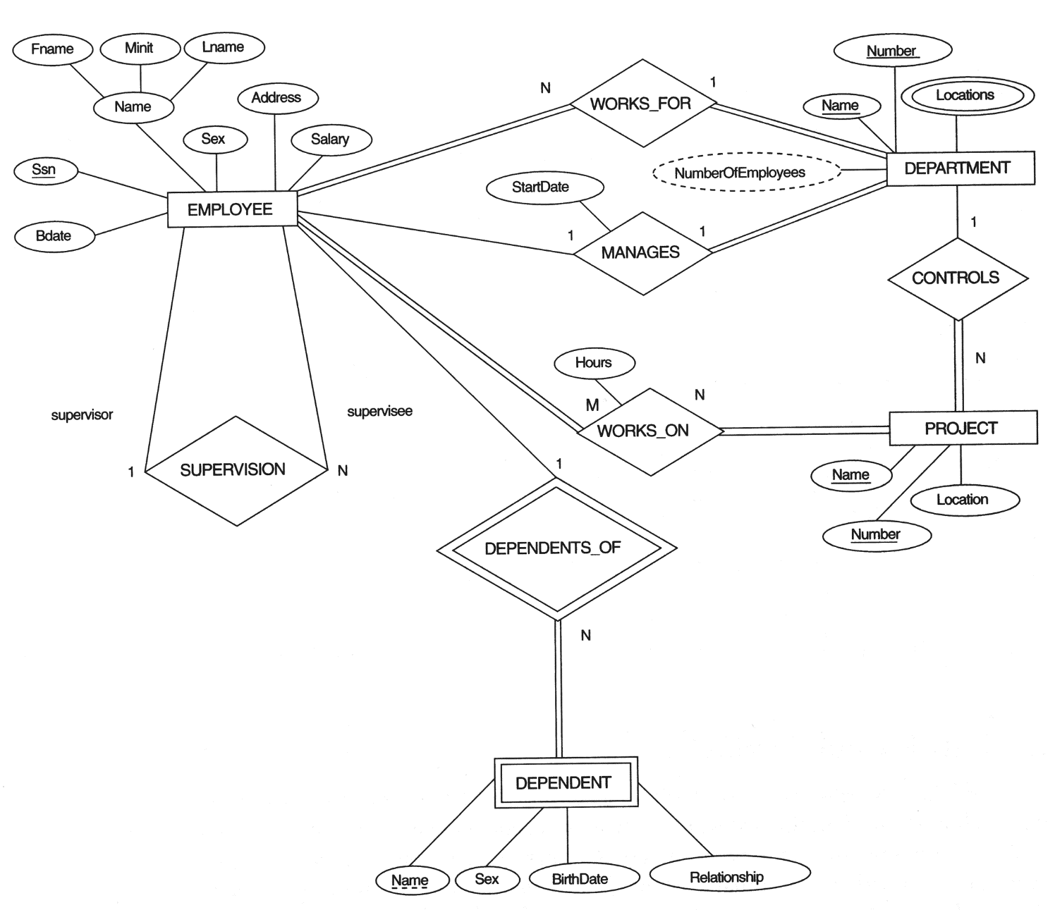

Slide 3
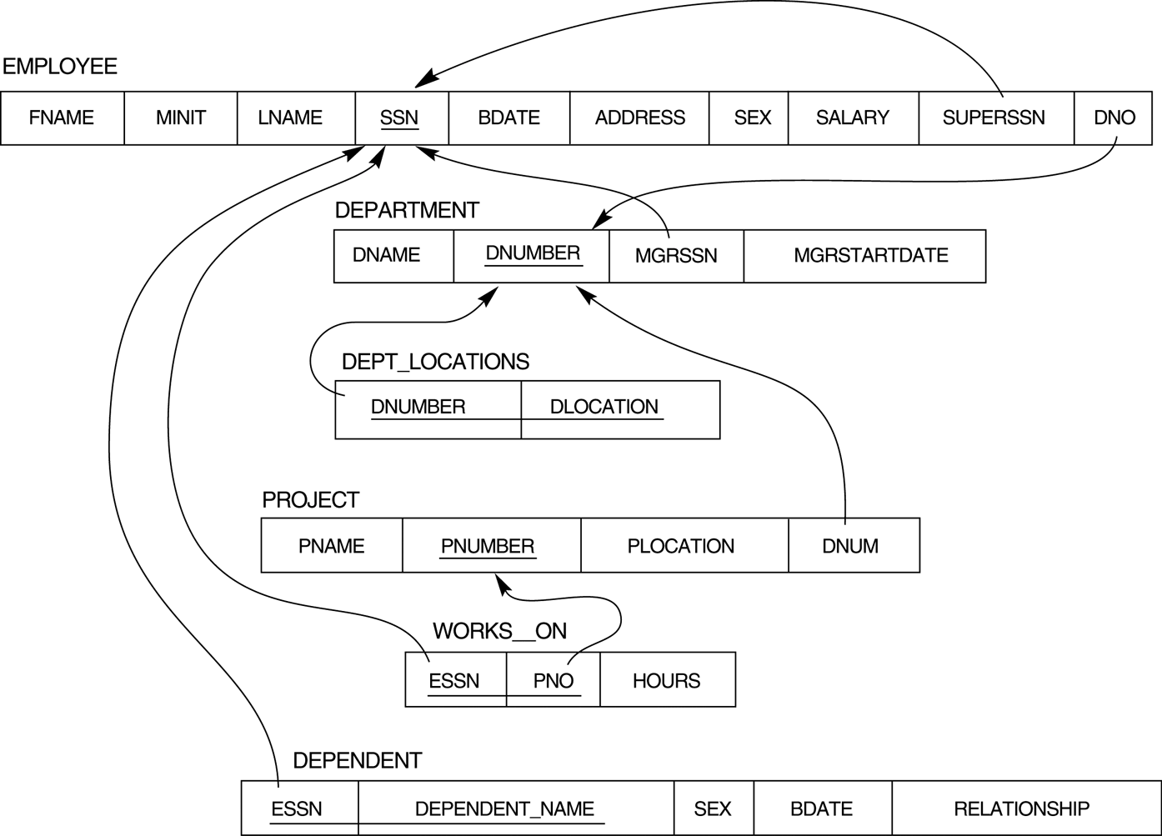
Resultant Logical Schema

Slide 4
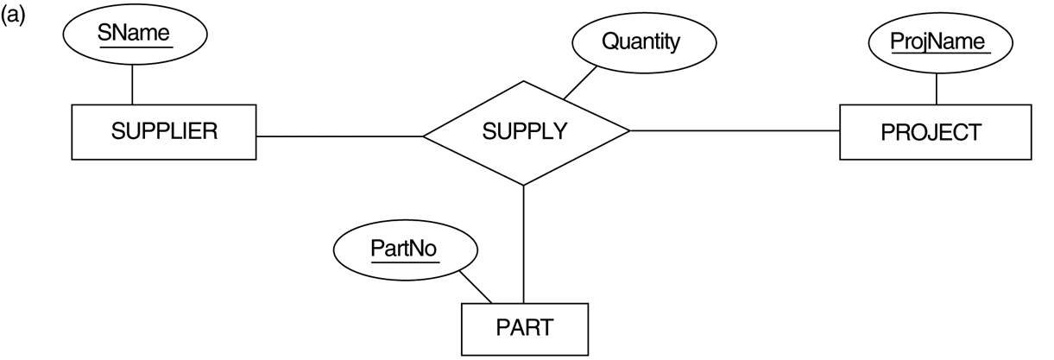
Ternary relationship types. (a) The SUPPLY relationship.

Slide 5
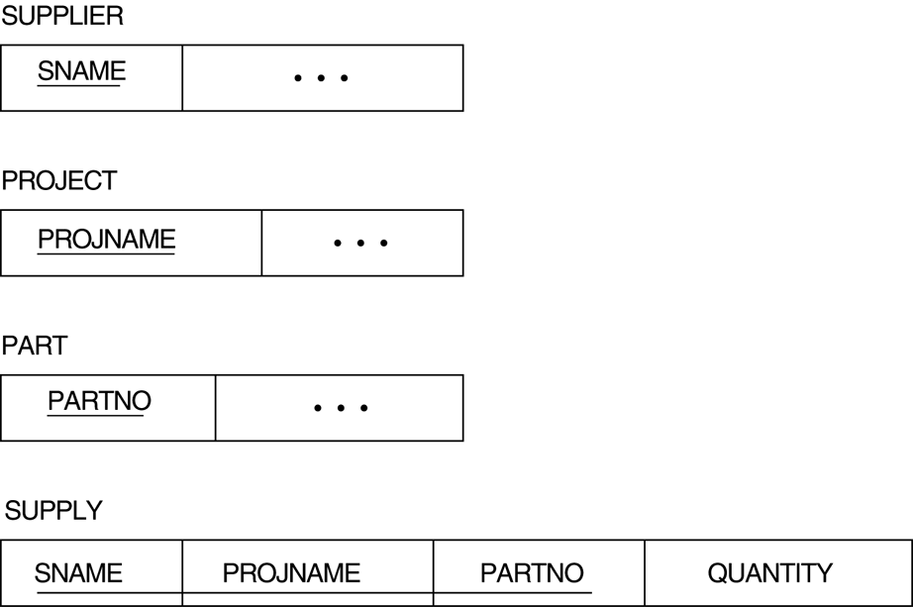
FIGURE 7.3 Mapping the n-ary relationship type SUPPLY from Figure 4.11a.

Slide 6
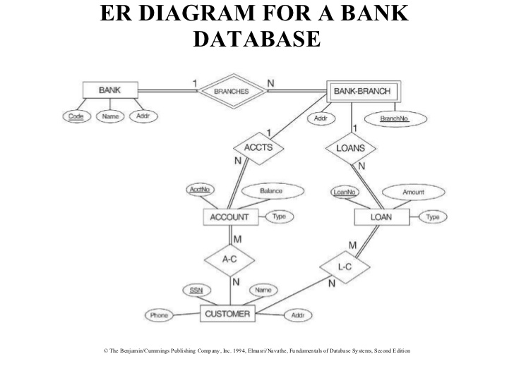
Class activity

Slide 7
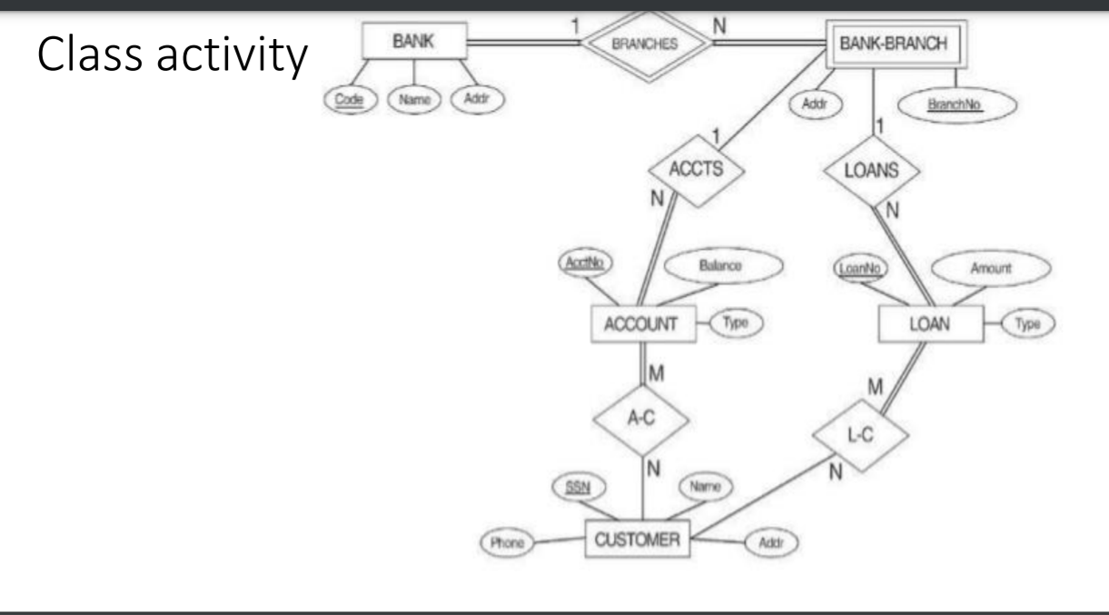
Bank
code | Name | Address
BankBranch
BranchNo | BCode | Address
Account
Accno | Balance | type | BranchNo | Bcode
Customer
ssn | name | phno | add
Loan
LoanNo | Type | Amount | BranchNo | Bcode
CustAcc
AccNo | SSN
CustLoan
LoanNo | SSn

Slide 8
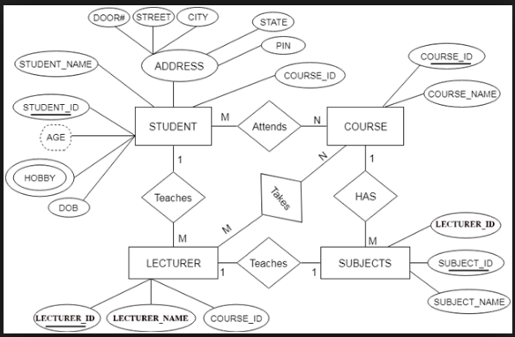
Class Activity 2
STAttendsCrs
St_Id | C_ID
Course
Course_ID | CourseName
StudentHobby
St_ID | Hobby
Student
St_ID | StName | DOB | Door# | Street | State | City | PIN | Major
Subject
Subject_ID | Lecturer_ID | Subject_NAme | Course_ID
Lecturer
Lecturer_Id | Lecturer_NAme | MAjor | Stu_ID

